Slide 1
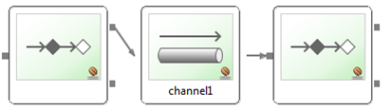
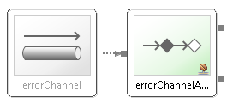
Message from queue channel – new thread
Exception in service
stickyWorkQueueMnager
Count hash using idExpression
Select proper executor by hash
OUTPUT CHANNEL
OUTPUT CHANNEL

